Slide 1

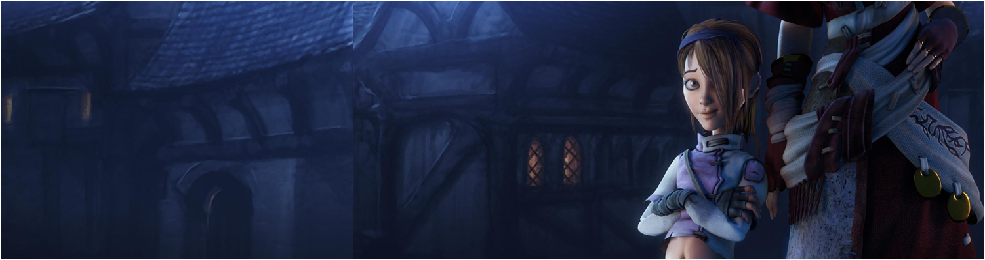

Lecture 2: Internet Protocol, Sockets and Robustness in data communications
COMP260: Distributed Systems
BSc (Hons) Computing for Games

Slide 2
Today’s session:
The Internet Protocol (IP)
Programming with Sockets
Robust socket communications

Slide 3
The Internet Protocol (IP)

Slide 4
The Internet Protocol (IP)
The internet as we know it comes from research work that was undertaken by US Defence Research Group (DARPA) & ARPANET and advised by the RAND Corporation
Develop a packet-switched network that was fault tolerant (height of the cold war)
Rather than circuit switched
Initially used by US academic institutes to share resources, research and communications

Slide 5
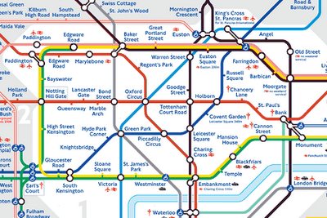
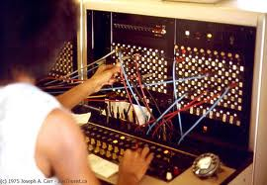
The Internet Protocol (IP)
Why is packet-switching important
Making the most efficient use of your resources
A circuit-switched London Underground would have 1 train per line
A packet-switched London Underground could have 1 train per station

Slide 6
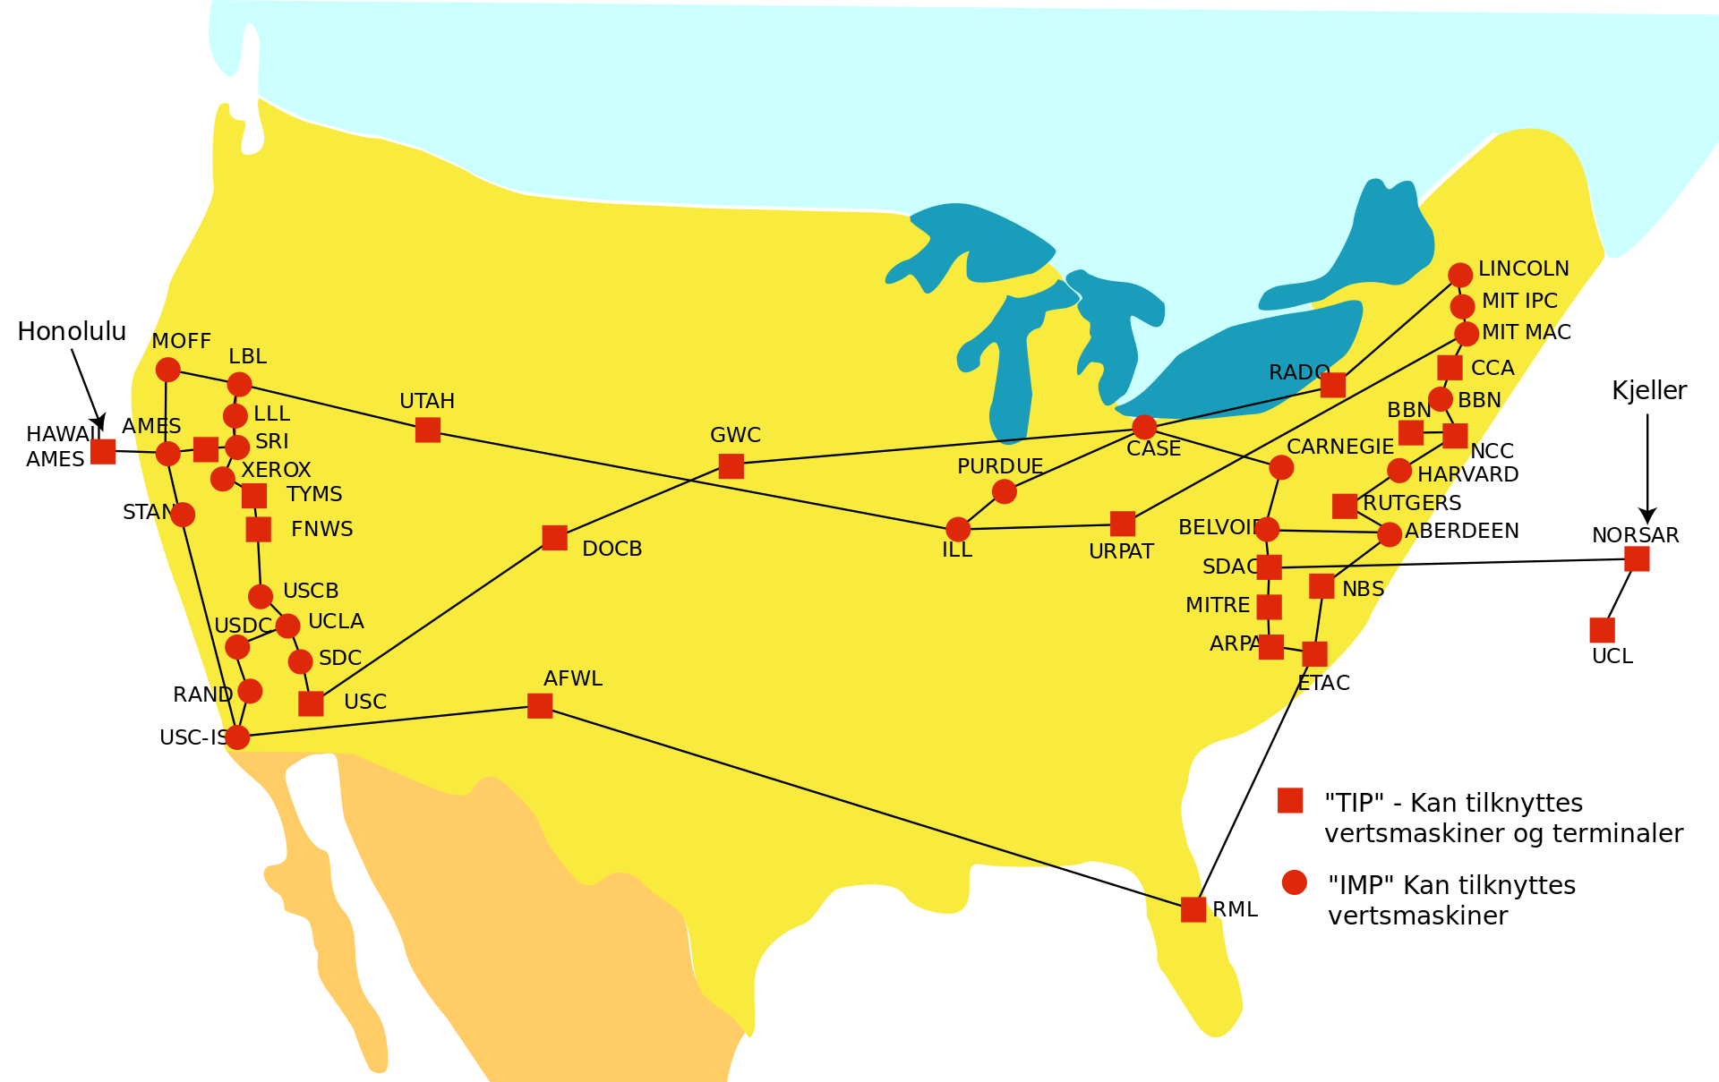
The Internet Protocol (IP)
Why is packet-switching important
Effectively network-based route-finding
If a node is ‘lost’, the network can re-route packets

Slide 7
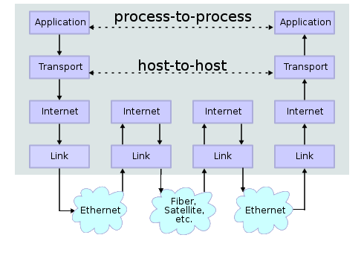
The Internet Protocol (IP)
Internet protocol
From a software developer’s perspective, an application using the IP to communicate works across platforms (they don’t have to think about the underlying stack)

Slide 8
The Internet Protocol (IP)
Internet protocol
From a software developer’s perspective, an application using the IP to communicate works across platforms (they don’t have to think about the underlying stack)
From a network engineer’s perspective, nodes can be connected using whatever link protocols make sense.
The internet is an open standard

Slide 9
Programming with Sockets

Slide 10
Programming with Sockets
There are TWO key protocols that are built on top of IP
TCP/IP
UDP/IP
(other protocols are available, these are just the most relevant to game development & operations)

Slide 11
Programming with Sockets
TCP & UDP are host-to-host (transport) protocols
Your application uses them to communicate with
Generally, you don’t care what happens at the internet & link levels

Slide 12
Programming with Sockets
TCP/IP
Transmission Control Protocol
‘Safe and steady’
All you packets will arrive at their destination (if it’s reachable)
In the same order they left
May well stall a lot trying to retry and sequence
Under the hood, there is a lot of handshaking and acknowledgement of packets

Slide 13
Programming with Sockets
UDP/IP
User Datagram Protocol
‘fast and loose’
Data may get to where it’s going
It may not
The order wrong It may turn up in
Under the hood, there is no handshaking or acknowledgement of packets
Send the data and hope for the best

Slide 14
Programming with Sockets
Generally:
TCP/IP when you absolutely want the data to get where it’s going and you can stomach the pauses
Data that you care about arriving
A lot of web protocols are built on top of TCP
FTP, HTTP / HTTPS, POP / SMTP, SSL, Telnet etc
UDP/IP when data arriving is a bonus
An app / service cares more about performance than delivery
Skype, Netflix?, Spotify?, Youtube?
A lot of streaming web services are built with UDP
VoIP, audio / video streaming etc

Slide 15
Programming with Sockets
Within games
UDP/IP
Very popular with ‘early’ network games (LAN-based FPS)
Trade TCP reliability with UDP performance to transmit data without stalling
Loss of data dealt with through client-side prediction
TCP/IP
Becoming more popular with higher performance and more reliable networking infrastructure
less packet loss leading to stalling
Used massively for early web turn-based games & chat services

Slide 16
Programming with Sockets
Two roles to consider
Server
Client
Generally, the server is what does the work and the client is what connects to the server to request the work is done

Slide 17
Programming with Sockets
Server Use Case | Client Use Case
Create a socket Listen for clients Accept new connection(s) Receive and send data Close connections | Create a socket Connect to server Receive and send data Close connections

Slide 18
Socket Programming
As a sequence diagram
Client
Server
Create a Socket
Create a Socket
Bind to IP & port
Set listen count
Connect to IP & port
Accept connect request
Receive message
socket.recv()
Send message
socket.send()
Send message
socket.send()
Receive message
socket.recv()
End
socket.close()
End
socket.close()

Slide 19
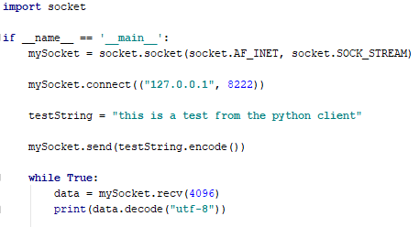
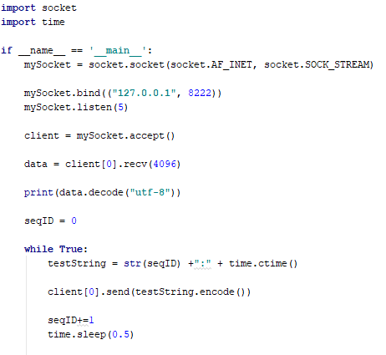
Socket Programming
In Python
Client
Server

Slide 20
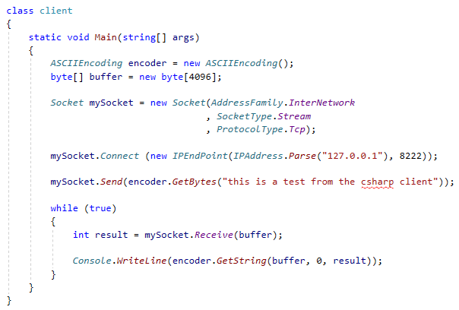
Socket Programming
In C#
Client

Slide 21
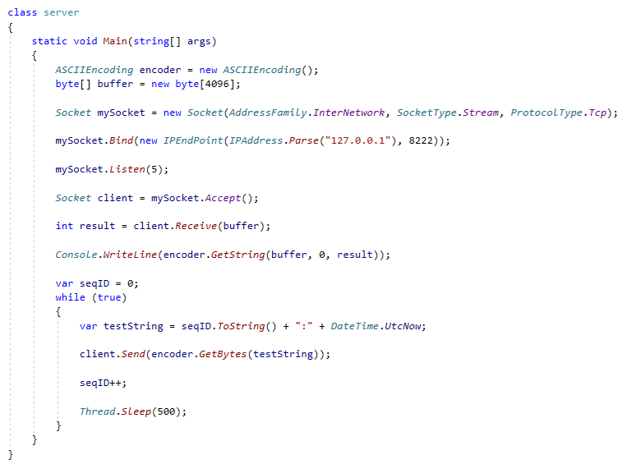
Socket Programming
In C#
Server

Slide 22
Socket Programming
Regardless of programming language
Sockets work in the same way
Create, bind, listen, connect, accept, send receive, close
‘Broadly’ equivalent to working with files (open, read, write, close)
Data is sent as a stream of bytes
Convert data to bytes (serialise)
Send it as bytes
Receive it as bytes
Convert bytes to data (de-serialise)
This makes it ‘easy’ to communicate between applications, machines and operating systems
Sockets are relatively platform agnostic
Bar endianness issues (hence, use of JSON in some cicumstancies)

Slide 23
Robust socket communications

Slide 24
Robust socket communications
How do we make socket communications robust?
What can go wrong?
Network communications relies on client and server roles
What happens if one isn’t around?
Generally, C# & Python will throw exceptions to deal with this
Your job as a coder is to handle those exception
Exceptions will tell you if:
The server isn’t running / has stopped running
A client has stopped running

Slide 25
Robust socket communications
Exception possibilities and what they mean
Client
mySocket.connect()
The server isn’t running or is at listen capacity.
Need to wait for a while and have another go
mySocket.send()
The server has stopped running and you are disconnected. Need to re-connect
mySocket.recv()
The server has stopped running and you are disconnected. Need to re-connect

Slide 26
Robust socket communications
Exception possibilities and what they mean
Server
mySocket.send()
The client has stopped running.
You need to accept a new client
mySocket.recv()
The client has stopped running.
You need to accept a new client

Slide 27
Robust socket communications
Need to think about the client and server as state machines and program accordingly
Server
accept
receive
send
Wait for a client
Receive
message
Send
message
catch exception
Client
connect
send
receive
Connect to server
send
message
Receive
message
catch exception

Slide 28
Robust socket communications
If we are working with different languages, operating systems and hardware
Managing data (even as bytes) can be tricky
One approach is to use JSON (JavaScript Object Notation) to manage data
Serialise objects into strings -> bytes
Deserialise byes in strings -> objects

Slide 29
Robust socket communications
JSON
Is part of Python with json
Json.dumps(object)
Generate the json string for an object
Json.loads(string)
Generate a Python object based on the string
Can access as a dictionary

Slide 30
Robust socket communications
JSON
In C#, use Newtonsoft JSON.net
JsonConvert.SerializeObject(object)
Generate the json string for an object
JsonConvert.Deserialize<T>(string)
Generate a C# object of type T based on the string

Slide 31
Questions

